Slide 1
Project Report-1: Amazon Sales Analysis
Technologies: Data Science/Analysis
Domain: E-commerce
Details: This Data includes sales details in different regions between years 2010-2017.

Slide 2
1.INTRODUCTION:
Purpose: The purpose of this report is to analyze the Amazon sales dataset to gain insights into sales trends, customer behavior, and product performance.
Scope: The report will cover key metrics such as sales revenue, product categories, customer demographics, and seasonal variations in sales.
Background: Amazon is a leading e-commerce platform known for its vast product offerings and global reach. Analyzing the sales dataset can provide valuable information for optimizing marketing strategies and improving overall sales performance.

Slide 3
2.ANALYSIS:
1.Univariate Analysis:
Continuous - column which are measurable and uncountable in nature - we used histograms and box plot
Categorical - column which have categories as it data - we used bar charts

Slide 4
a) Continuous Variable Distribution
Unit Price - most of the unit price is within 180 dollar value as shown by the median value. The maximum unit price can be seen 668.27 and there is not any outliers as can be seen from the box plot.
Unit Cost - most of the unit cost is within 107 dollar as is shown by the median value. From box plots we can say again here we do not have any outliers, the maximum unit cost we have is around 525 dollars.
Total Revenue - most of the Total Revenue generated lies below 7.5e+05 dollars as seen from median value and also the highest bar in histogram. However from the box plot we can see three outliers on the higher side with maximum of around 6e+06 dollars.
Total Cost - most of the Total Cost lies below 3.6e+05 dollars as seen from median value and also the highest bar in histogram. And also same as in Total Revenue, from the box plot we can see three outliers on the higher side with maximum of 4.5e+06 dollars.

Slide 5
Total Profit - As profit is simply difference of Total Revenue and Total Cost, most of the Total Profit values is within 2.907680e+05 dollars as is shown by the median value. From the box plot we can see we have more than 3 outliers for this column with maximum value of 1.7e+06 which is a number more than the average total revenue.
Unit Profit - Unit profit is simply the difference of Unit Price and Unit Cost, and most of the Unit Profit is within 74 dollar as is shown by the median value. From box plots we can say again here we do not have any outliers, the maximum unit profit we have is around 174 dollars.
Units Sold - Most of the units Sold lies within 5383 units as can be seen from the median value. From box plots we can say again here we do not have any outliers, the maximum Units Sold is 9925 units and minimum we have is 124 units.
Shipping Duration - most of the values in shipping duration is within 24 days as is shown by the median value and also the deviation or spread of data is lesser. Clearly, we do not have any outliers here, the maximum and minimum values are 50 and 0 days.

Slide 6
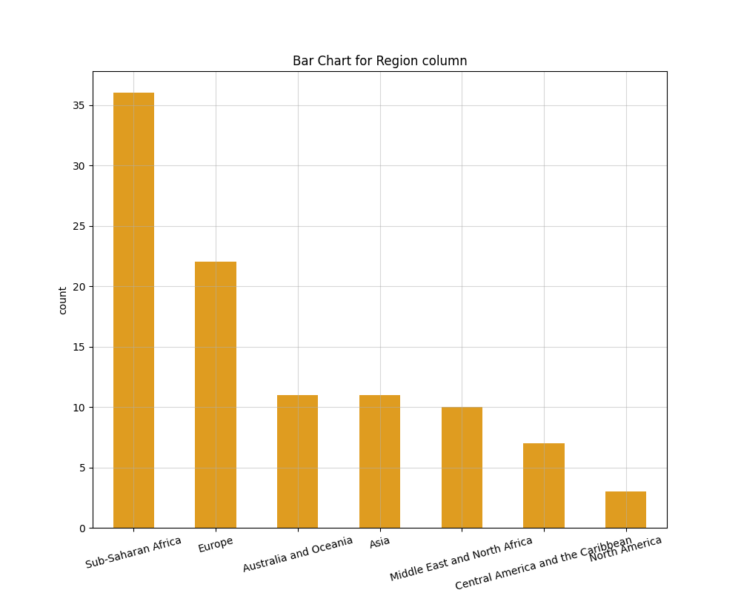
b) Categorical Variable Distribution
The most common regions are Sub-Saharan Africa (37) and Europe (24).

Slide 7
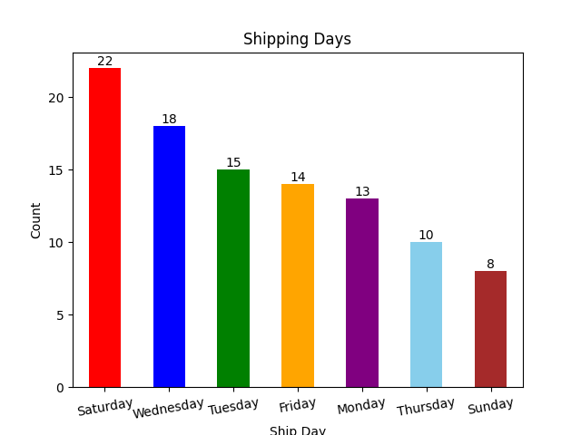
Time based categorical variables:
Ship day-wise
Most of the shipping is happening on Saturdays and Wednesdays and least on Sundays.

Slide 8
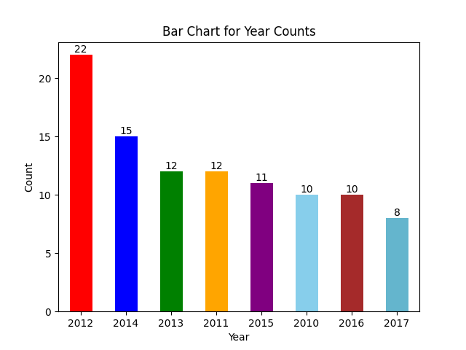
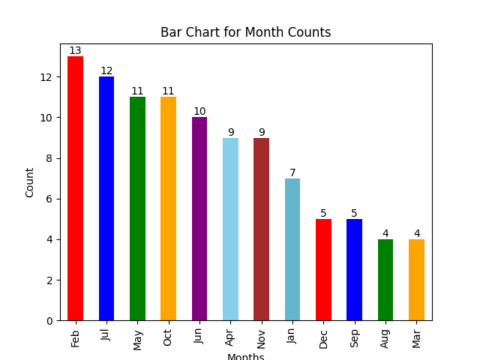
Monthly and Yearly Sales Trend
a) Most of the entries are of year 2012 and 2015.
b) Most of the entries are of month Feb, Jul, May, Oct.

Slide 9
Insights From Univariate Analysis:
Unit Price - Most of the unit price is within 180 dollar value as shown by the median value. The maximum unit price can be seen 668.27 and there is not any outliers as can be seen from the box plot.
Unit Cost - Most of the unit cost is within 107 dollar as is shown by the median value. From box plots we can see here again we do not have any outliers, the maximum unit cost we have is around 525 dollars.
Total Profit - Most of the Total Profit values is within 2.9e+05 dollars as is shown by the median value. From the box plot we can see we have more than 3 outliers for this column with maximum value of 1.7e+06 which is a number more than the average total revenue.
Units Sold - Most of the units Sold lies within 5383 units as can be seen from the median value. From box plots we can say again here we do not have any outliers, the maximum Units Sold is 9925 units and minimum we have is 124 units.

Slide 10
Shipping Duration - Most of the values in shipping duration is within 24 days as is shown by the median value and also the deviation or spread of data is lesser. Clearly, we do not have any outliers here, the maximum and minimum values are 50 and 0 days.
Sales Channel - Both the modes of sales are being equally used (Offline and Online 50-50)
Item Type - Most of the item types are Clothes, Cosmetics and Office Supplies
Region - The most common regions are Sub-Saharan Africa (37) and Europe (24).
Country - Most of the countries have only one unique entry ( 83% )
Shipping day name - Most of the shipping is happening on Saturdays and Wednesdays and least on Sundays
Month - Most of the entries are of month Feb, Jul, May, Oct and then kept on decreasing.
Year - Most entries are for the year 2012 and the entries mostly kept on decreasing after it.

Slide 11
2.Bivariate Analysis
We need to find out Sales-trend: month wise , year wise , yearly-month-wise
We can explore the relationship of these with continuous variables such as:
Total Profit
Units Sold
Next we can find relationship of item types with:
Unit Profit
Units Sold

Slide 12
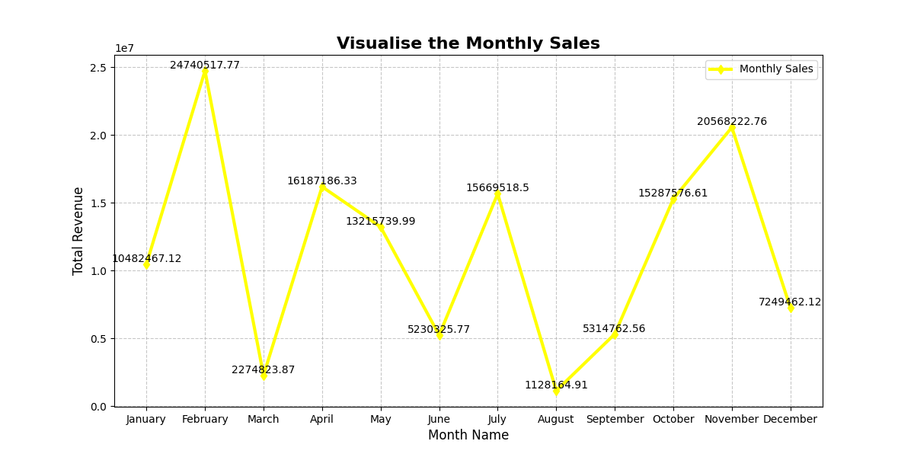
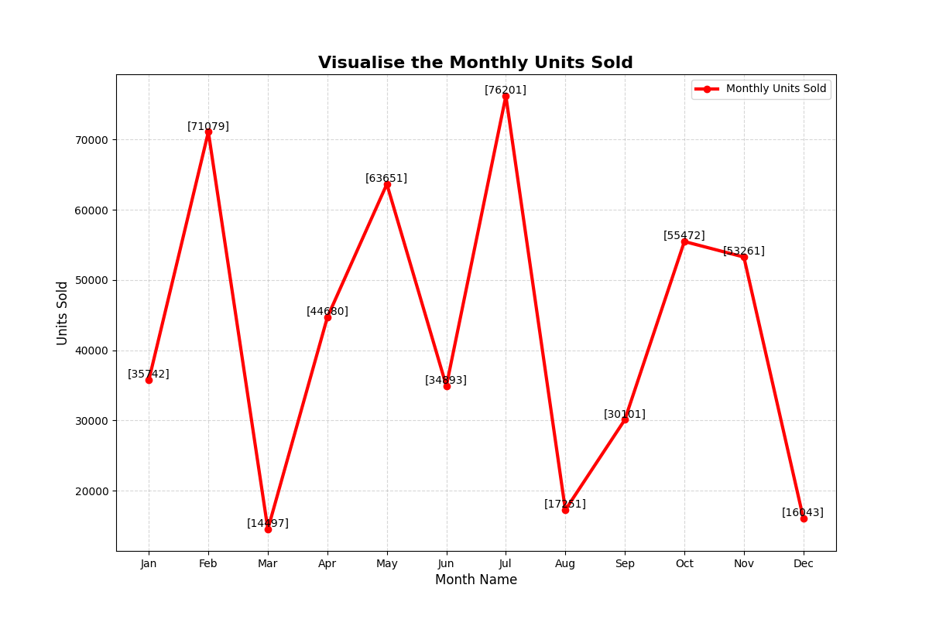
Month-wise Sales: a) Month and Revenue generated in it, b) Month and Unit Sold in it.
Insights:
a) Highest Profit made in month February(approx. $24.5M) and November (approx. $20.3M) and minimum in August(approx. $1.2M) and March (approx. $2.3M).
b) Highest Units Sold are in Jul(76.2k) followed by Feb(71k), and least in Aug(14.5k), March(17.2k) and Dec(16k).

Slide 13
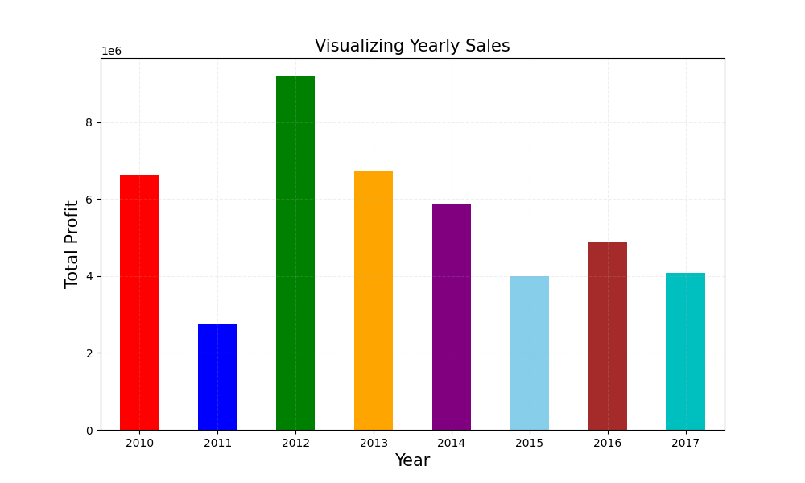
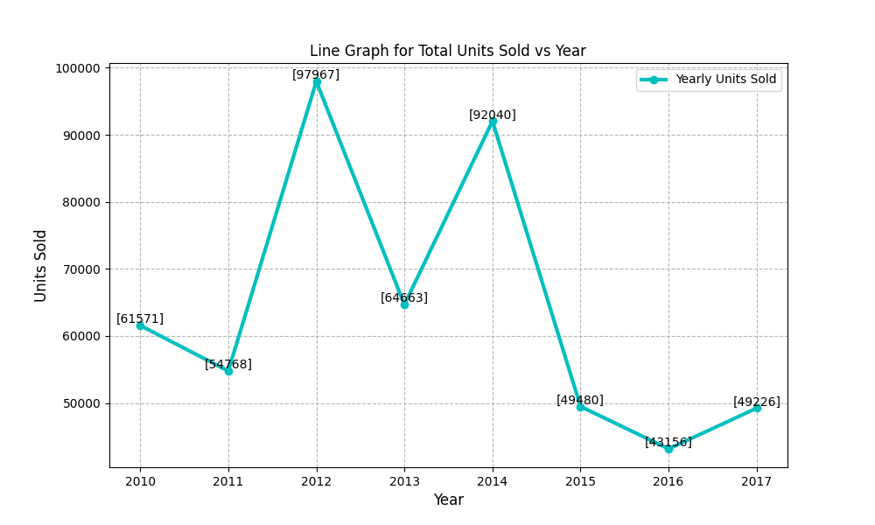
Yearly Sales: a) Year and Profit generated in it, b) Year and Unit Sold in it.
Insights: a) Maximum Profit is in year 2012 and Minimum in 2011.
b) We can see two peaks one at year 2012 and next at 2014. They are max unit sold in year.

Slide 14
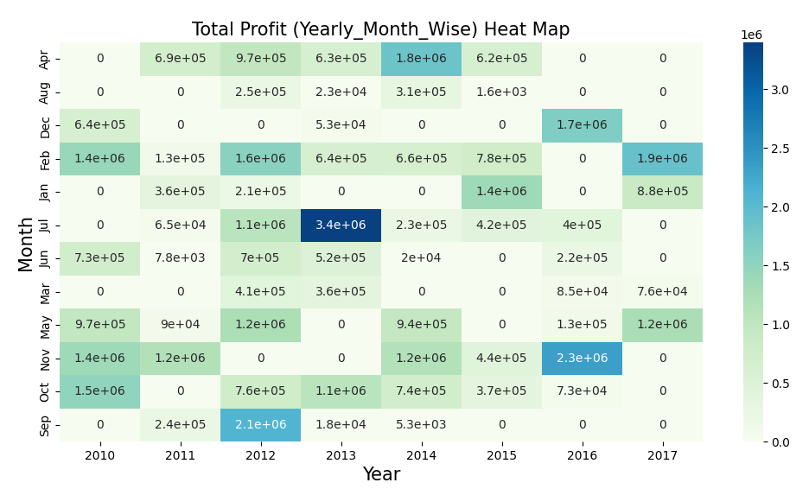
Yearly-Month-Wise Sales and Profit
Above Heat map between Year-Month and Profit represents the Profit in Particular Month of Particular Year (e.g. January 2012 Profited an amount of $ 3.4M).

Slide 15
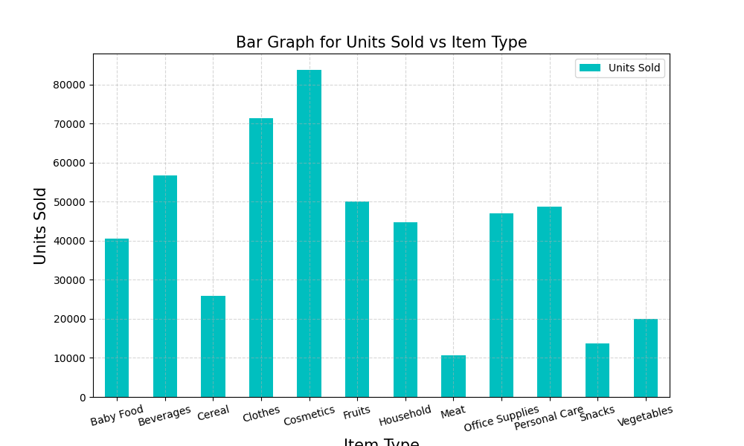
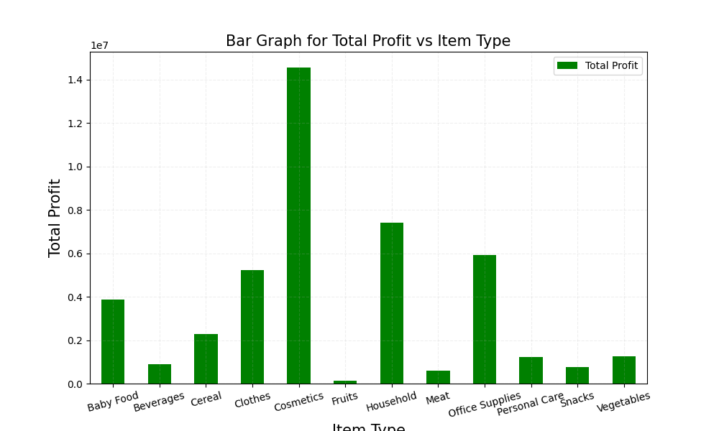
Item-wise Sales and Profit
Above graphs Shows that’s most Items sold are from “Cosmetics” and “Clothes” in left one On the other hand most profitable items includes “Cosmetics” and “Households”.

Slide 16
Final Results From EDA:
Following insights can be helpful to improve the sales of the company:
Unit Price - Most of the unit price is within 180 dollar value as shown by the median value. The maximum unit price can be seen 668.27 and there is not any outliers as can be seen from the box plot.
Unit Cost - Most of the unit cost is within 107 dollar as is shown by the median value. From box plots we can see here again we do not have any outliers, the maximum unit cost we have is around 525 dollars.
Total Profit -Most of the Total Profit values is within 2.9e+05 dollars as is shown by the median value.
From the box plot we can see we have more than 3 outliers for this column Maximum total profit appears in months Feb and Nov , and least in Mar and Aug Also the total profit is maximum for year 2012 and least in 2011 And maximum profit is obtained from cosmetics and minimum with food items such as Fruits, beverages and meat.
Units Sold - Most of the units Sold lies within 5383 units as can be seen from the median value. From box plots we can say again here we do not have any outliers, the maximum Units Sold is 9925 units and minimum we have is 124 units.

Slide 17
We can see highest units sold are in Jul month followed by Feb, and least in Aug, March and Dec
Maximum units were sold at year 2012 and next at year 2014
Clothes and Cosmetics have the maximum units sold, meat is minimum
Shipping Duration - Most of the values in shipping duration is within 24 days as is shown by the median value and also the deviation or spread of data is lesser. Clearly, we do not have any outliers here, the maximum and minimum values are 50 and 0 days.
Item Type - Most of the item types are Clothes, Cosmetics and Office Supplies
Region - The most common regions are Sub-Saharan Africa (37) and Europe (24).
Shipping day name - Most of the shipping is happening on Saturdays and Wednesdays and least on Sundays

Slide 18
Some Key Matrices
Total Sales And Revenue Generated: Total Unit Sold: 512.87 K & Total Revenue: $137.35 M.
Total Profit: $44.17 M
Average Sales: 5128.71
Average Revenue: $1373487.68
Average Profit: $ 441681.98

Slide 19
3.CONCLUSION:
Summary of Findings: The analysis of the Amazon sales dataset revealed significant insights into sales trends, customer preferences, and product performance. Key findings include the top-selling product categories, peak sales periods, and customer demographics.
Recommendations: Based on the findings, it is recommended to focus marketing efforts on high-performing product categories, tailor promotions to target specific customer segments, and optimize inventory management during peak sales periods.
Future Work: Future research could explore the impact of external factors like economic conditions on sales, conduct A/B testing for marketing strategies, and analyze customer feedback to enhance the overall shopping experience.

Slide 20
THANKYOU

